Slide 1
Measures of spread
EQ: How can we use different measures of spread?
Syllabus point: 2.1.12 interpret statistical measures of spread, such as: the range, interquartile range and standard deviation

Slide 2
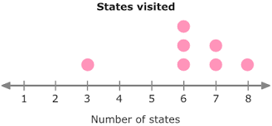
First 5
Measures of spread
EQ: How can we use different measures of spread?
For the following dot plot
Calculate the Mean
Calculate the Mode
Calculate the Median
Calculate the Range
Challenge: Calculate the interquartile range

Slide 3

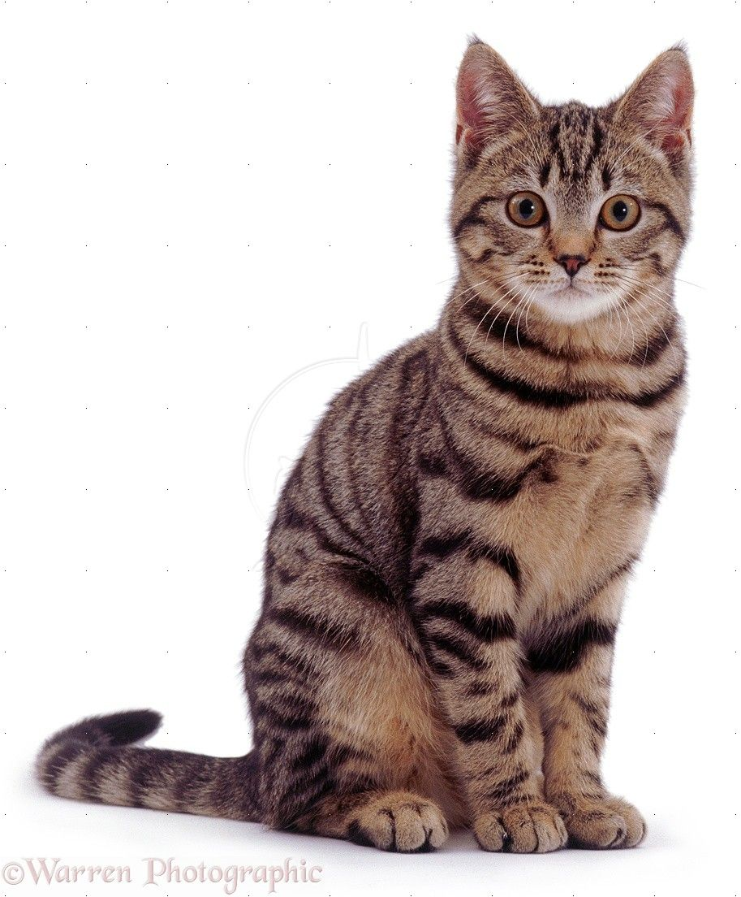
Quickwrite 2mins
Write down what you think a measure of spread and/or list all the measures of spread you know
My cat is 3 nutellas high!
This is not a measure of spread!

Slide 4
Measures of Spread | EQ: How can we use different measures of spread?
What are measures of spread?
Measures of spread measure how spread out your data is.
The 3 measures of spread we will be using are Range, Interquartile and Standard deviation.
The bigger you range, IQR and Standard deviation are the more spread out your data is. (less consistent)

Slide 5
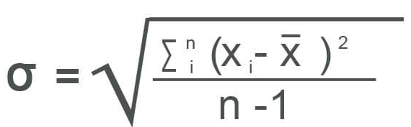
Measures of Spread | EQ: How can we use different measures of spread?
Standard deviation:
The average distance each data point is from the mean.
To calculate is we use this formula
What is standard deviation?
Luckily calculators and excel can calculate this for you, you just need to understand what it shows

Slide 6
Calculate the mean for the following 3 sets of data
8, 9, 10, 11, 12
9, 10, 10, 10, 11
10, 10, 10, 10, 10
Answer:
All the means are 10

Slide 7
Rank them in ascending order according to their standard deviation.
8, 9, 10, 11, 12
9, 10, 10, 10, 11
10, 10, 10, 10, 10
Correct order
C, B, A
c) Has a standard deviation of 0 as all the scores are the same.

Slide 8
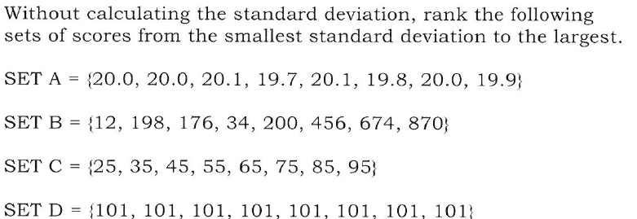
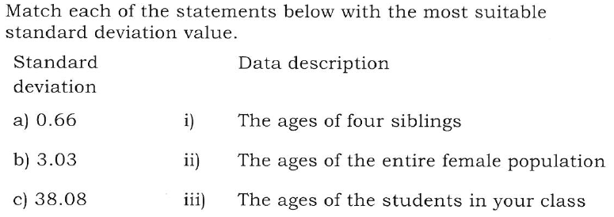

Slide 9
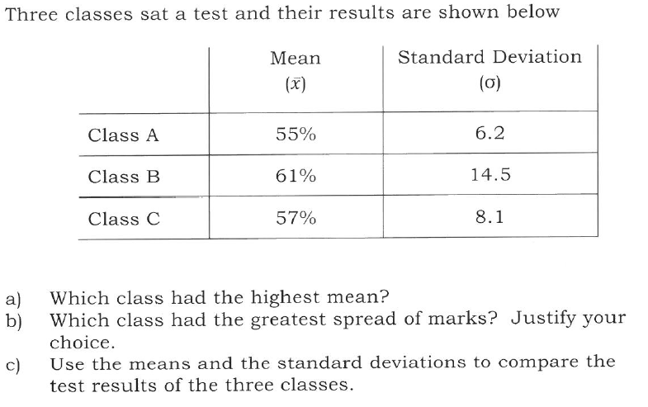
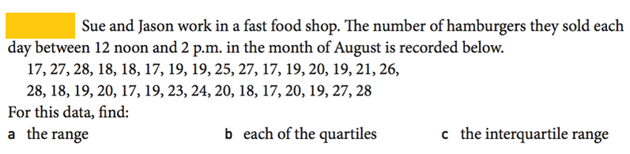

Slide 10
Closure summary sentence frame
Measures of spread tell us how spread out the data is. The common ones we use are range, interquartile range and standard deviation.
The larger the measure of spread is the more spread out the data is.

